Slide 1


Innovate. Transform. Excel
Insyllium.com

Slide 2

1. Introduction
Our mission is to provide high quality products and services by contributing to worldwide digitalization, empowering businesses with innovative solutions that enhance efficiency, drive growth, and inspire global progress.

Slide 3
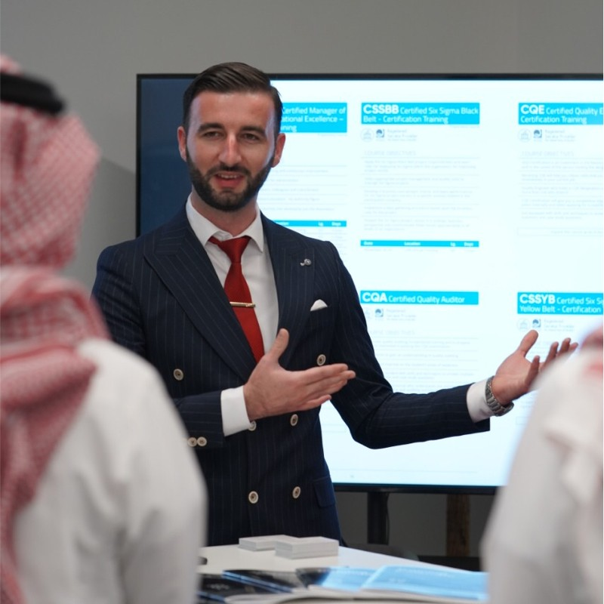
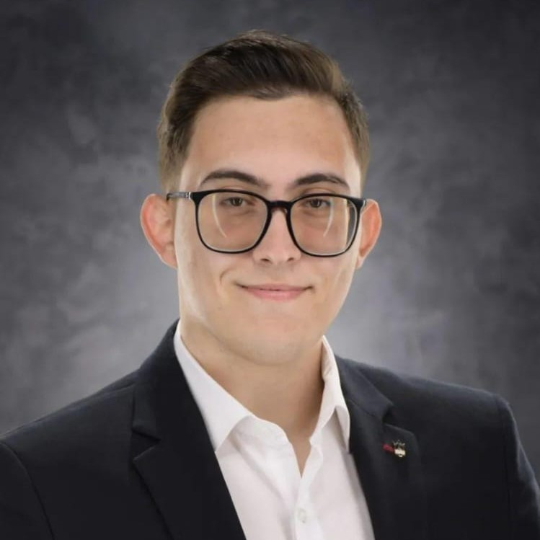
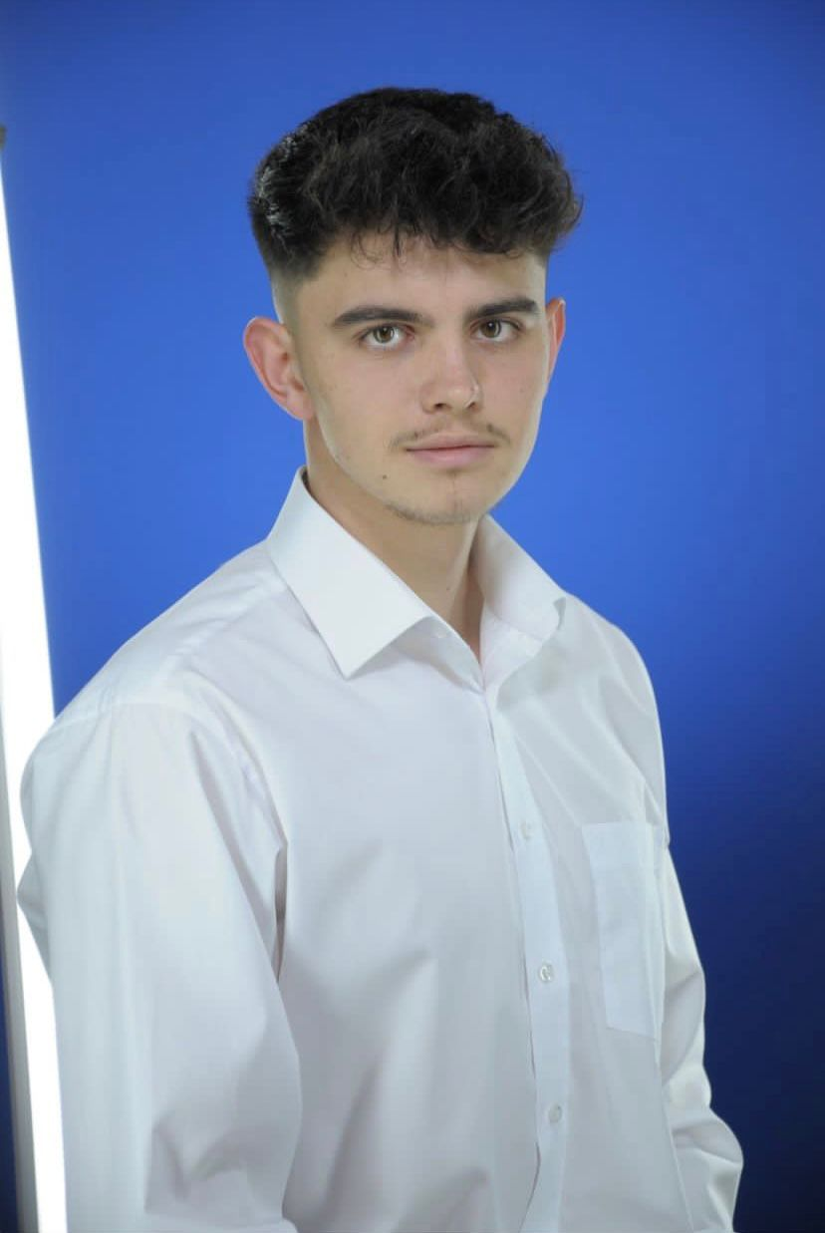
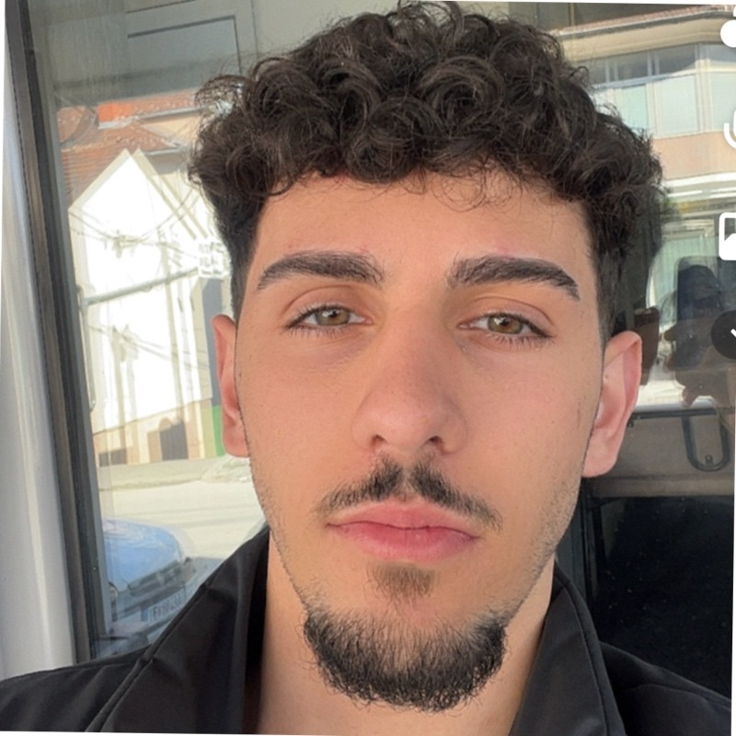
2. Management Team
Naim Ademi
Burim Hodai
Co-Founder
Sales & Marketing
Etnik Zeqiri
Co-Founder
Head of Design
Muiz Rexhepi
Co-Founder
Back-end Dev.
Co-Founder
Front-end Dev.

Slide 4
89%
3. Problem
Adapting to industry trends
Our agile approach to technology solutions equips businesses with the agility and flexibility needed to adapt quickly to changing market dynamics, ensuring long-term relevance and competitiveness.
56%
91%
Of all companies already have or plan to adapt a digital-first business strategy
Of CEO’s are saying digital Improvements have Increased their revenues
Of businesses are engaged in some form of digital initiative

Slide 5
4. Value Proposition
At Insyllium, we're dedicated to providing top-notch services.
Our software solutions not only solve current issues but also help businesses stay strong in a time when technology is changing quickly.
Contact us at insyllium@gmail.com

Slide 6
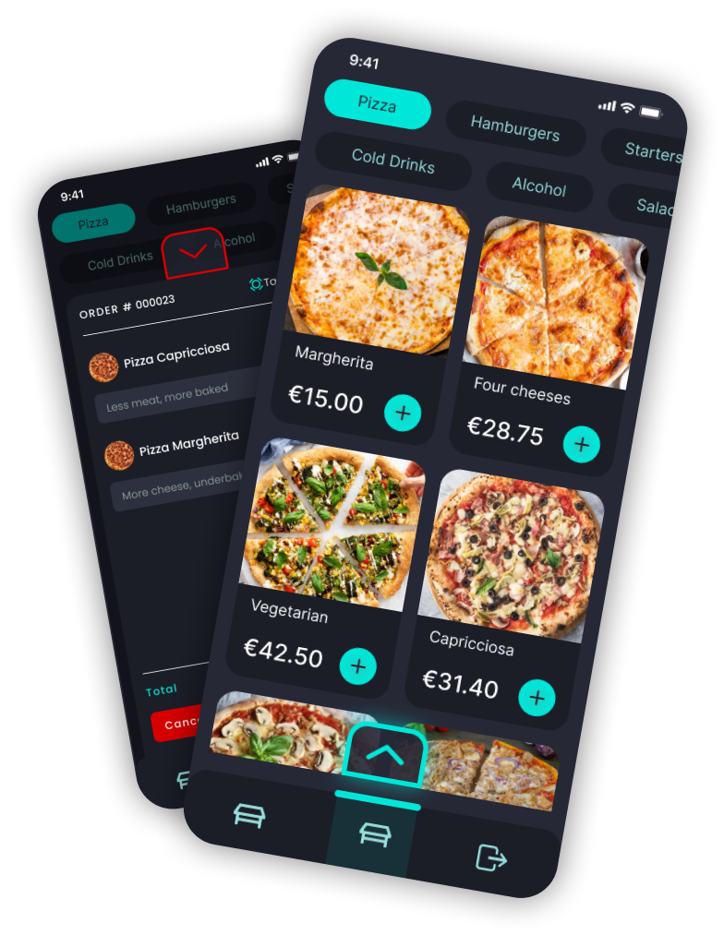

5. Underlying Magic
As a software company, we stand out because we always work to come up with new ideas and adapt quickly.
We're good at using the latest technology, making solutions that fit each business, and giving users a great experience.
Our focus is on being flexible, working together, and making sure our customers not only get answers to their current problems but also stay ahead in the changing digital world.
Innovative Customization
Collaborative Partnership
Strategic Problem-Solving

Slide 7
Custom Web & Software Development
06
Business
Model
Insylink Point of Sale
System (POS)
CRM Software with AI -
Coming soon
Restaurants & Coffee shops in need of a reliable POS system.
Visit at insylink.com
Small and medium-sized enterprises (SMEs) seeking to establish or enhance their digital presence.
Restaurants & Coffee shops in need of a reliable POS system.

Slide 8


Our partners
LANSGR
HAKBUS
Express Shutter Solutions.
Web Application and branding.
Visit the website at
lans-gr.com
Online booking – Transport & Logistics
Available on:
iOS/Android and Web.
Visit the website at
hakbus.org

Slide 9

Expansion to German market
Our POS system has been created with the specific goal of targeting the German market. The food and beverage industry can leverage the Insylink POS system, which incorporates the latest technology to provide end-to-end solutions for users.
As UEFA estimates that 20 million tickets have already been booked for EURO 2024 as of now, it is anticipated that restaurants and cafes will experience a surge in customers, leading to overcrowded establishments. This is where Insylink comes in, aiming to simplify their operations and enhance efficiency during this high-demand period.
German market
Europe

Slide 10
2024
7. Go-to-market plan
Ideal customer
Our target customers include healthcare providers, retail businesses, food and beverage establishments, banks, real estate companies, and governmental organizations
We aim to address their specific needs, such as streamlining processes, enhancing customer experiences, and improving overall efficiency, through custom software solutions designed to meet their unique challenges.
Establishing Presence & Building Foundation
2025
Acquisition
Expansion and Diversification
We are going to acquire users by focusing on these Marketing Channels: Content Marketing - Creating industry specific blogs & utilizing SEO. Social Media Marketing – Share engaging content on platforms like Linkedin, Twitter, Instagram Industry Events and Partnerships: Attend or sponsor relevant industry events across EMEA. Referral Programs – Encourage satisfied clients to refer our services to other businesses.
Scale
2026
Retention & Upselling
Continues Improvement
Upselling Strategies
Strategic Partnerships
Industry Collaborations
Resellers Programs
Scalable Infrastructure
Cloud-Based solutions
Optimization and Sustainability

Slide 11




8. Competitor analysis
Easy to use
That’s us!
Competitive Advantages
Embracing emerging technologies such as AI, data analytics, and contactless payment systems.
Our tailored POS system, customized for local languages and currencies, will position us as the market leader in our target international markets.
Expensive
Affordable
Difficult to use

Slide 12
9. Current status, accomplishments, use of funds
Current Status
Use of Funds
AUGUST
1
Accomplishments
Registered company in N. Macedonia
Product Marketing
Completed at least 3 customized projects: Web & Mobile app development, Customized Software development, - POS System
OCTOBER
2
Creation of our own product
Geographical Expansion
NOVEMBER
3
Our first local client for POS System
Supply of Technological equipment

Slide 13
THANK YOU!
Feel free to ask any questions!
insyllium@gmail.com
+389 71 604 221
Insyllium.com

